Slide 1


Spider Webs and Sacrificial Failure
Impact regimes and quasi-static capacity

Slide 2
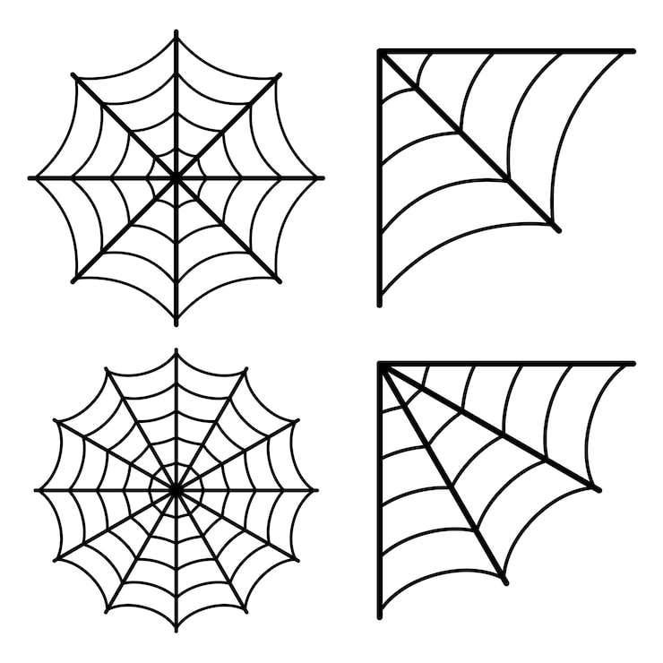
Agenda
A PHYSICAL MODEL
Single thread and impact regime
B
…
C SACRIFICIAL FAILURE
…
D NUMERICAL METHOD
…

Slide 3
Spider Webs
PHYSICAL MODEL

Slide 4
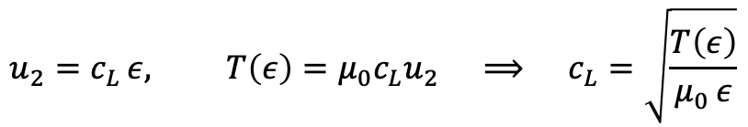
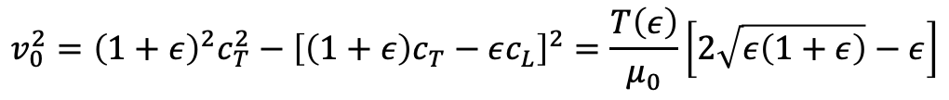
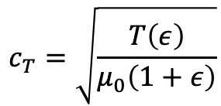
Impact waves in single thread
Consider a long thread along x, at rest and unstrained, whose point x=0 is suddenly given a constant transverse velocity v₀.
$$u_{2}=c_{L} ε, T\left(ε\right)=μ_{0}c_{L}u_{2} ⟹ c_{L}=\sqrt{\frac{T\left(ε\right)}{μ_{0} ε}}$$
$$c_{T}=\sqrt{\frac{T\left(ε\right)}{μ_{0}\left(1+ε\right)}}$$
$$v_{0}^{2}={\left(1+ε\right)}^{2}c_{T}^{2}−{\left[\left(1+ε\right)c_{T}−εc_{L}\right]}^{2}=\frac{T\left(ε\right)}{μ_{0}}\left[2\sqrt{ε\left(1+ε\right)}−ε\right]$$

